Slide 1

Data Interpretation & Communication Of Insights Of Data
Name : Nurullainy Binti Mat Rashid

Slide 2
INTRODUCTION
Crude Oil is a naturally occurring liquid fossil fuel resulting from plants and animals buried underground and exposed to extreme heat and pressure.
Crude oil is one of the most demanded commodities and prices have significantly increased in recent times. The demand for crude oil is dependent on global economic conditions as well as market speculation. Crude oil prices are commonly measured in USD.
Descriptive analysis are is important first step for conducting data interpretation. It gives us an idea of the distribution of the data, helps us to detect outliers and typos, and enable us to identify the trend and hidden pattern among variables, thus making us ready to conduct further advance analyses.

Slide 3
HISTOGRAM
Visualises the distribution of data over a continuous interval or certain time period. Each bar in a histogram represents the tabulated frequency at each interval/bin

Slide 4
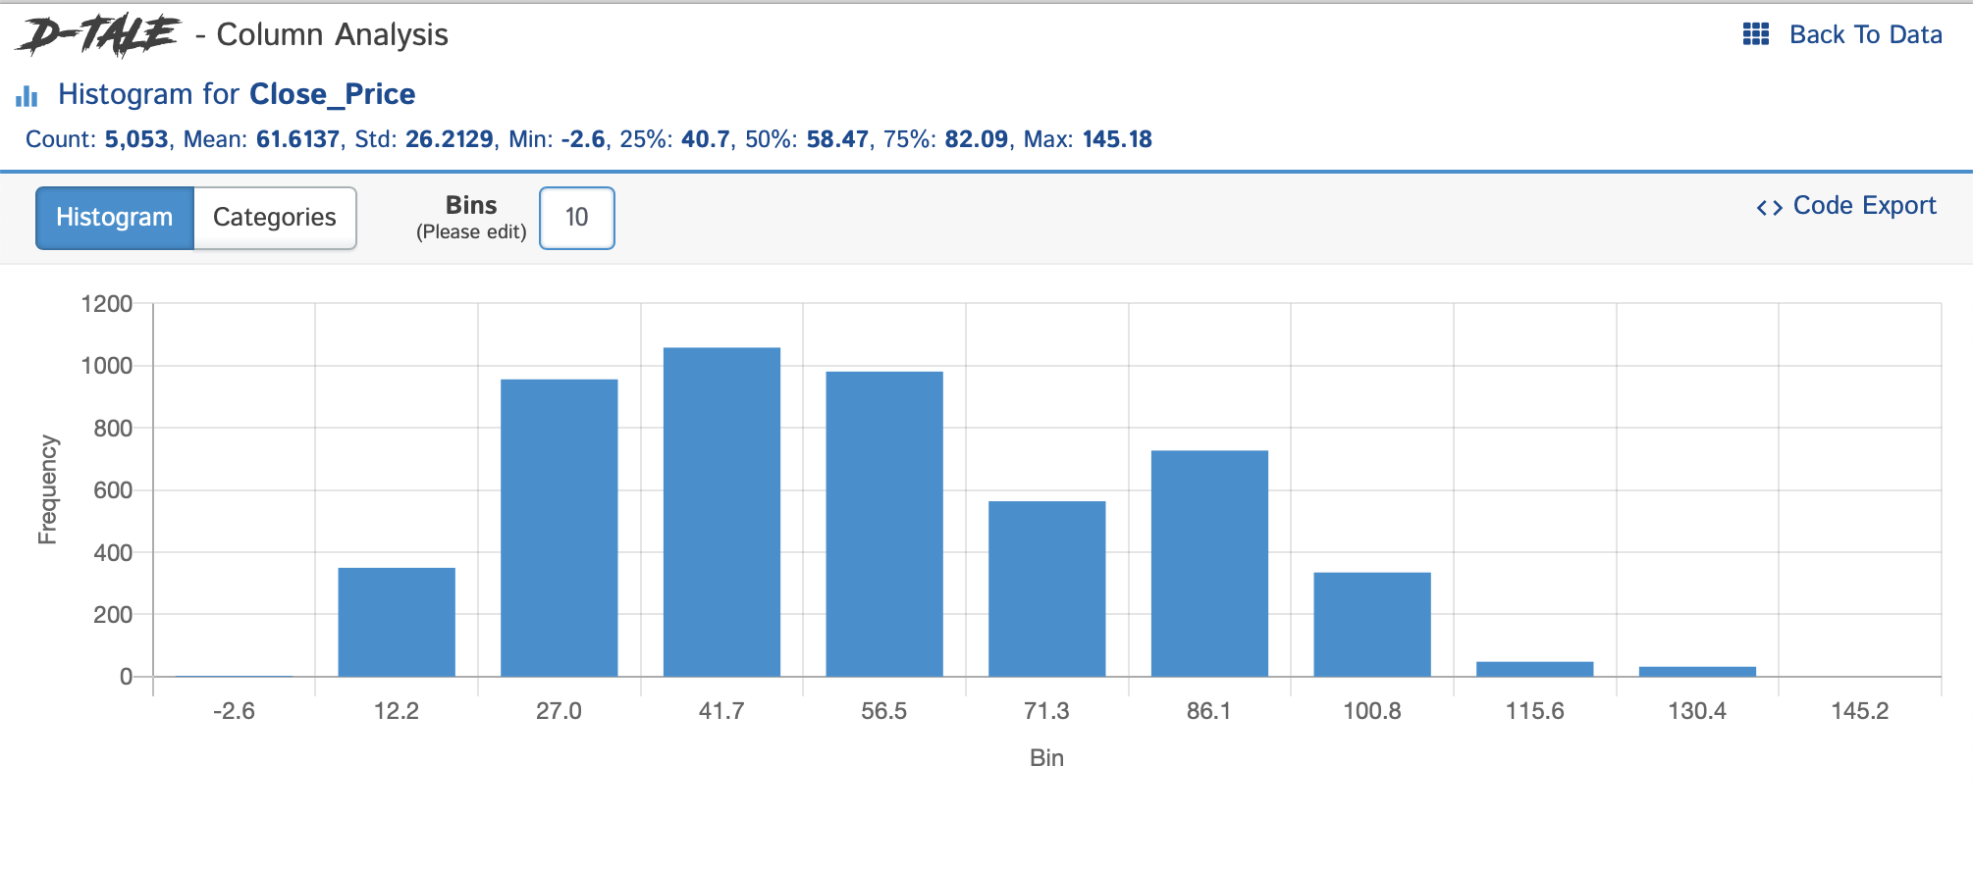
HISTOGRAM
Distribution of daily close price data over 20 years with tabulated frequency at each interval (10 bins)
Mean close price for crude oil in the past 20 years is USD 61.62 for both bins setting at 10 and 20

Slide 5
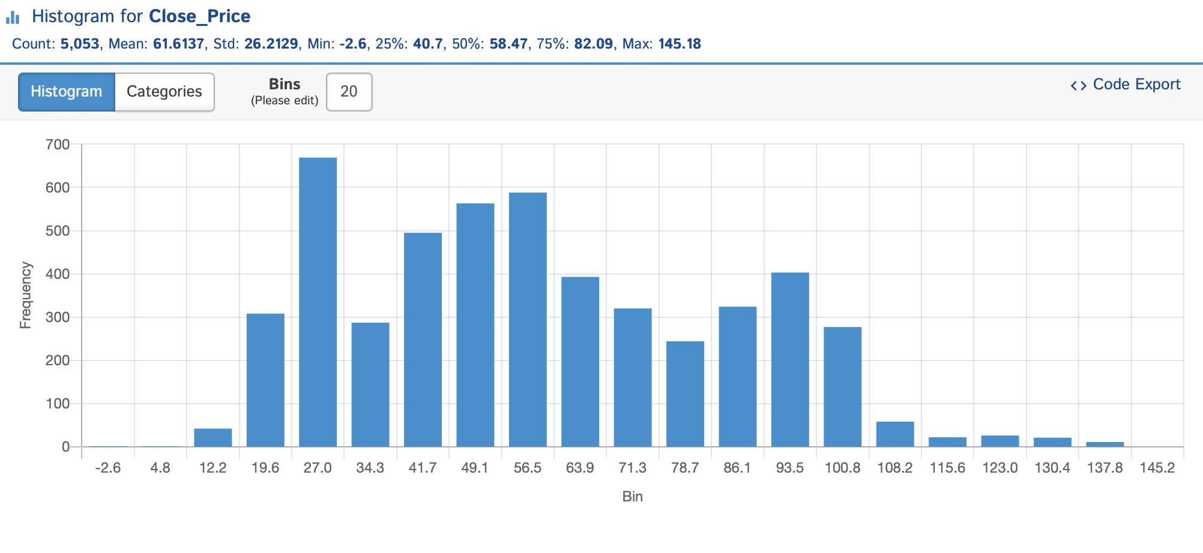
HISTOGRAM
Distribution of daily close price data over 20 years with tabulated frequency at each interval (20 bins)
Mean close price for crude oil in the past 20 years is USD 61.62 for both bins setting at 10 and 20

Slide 6
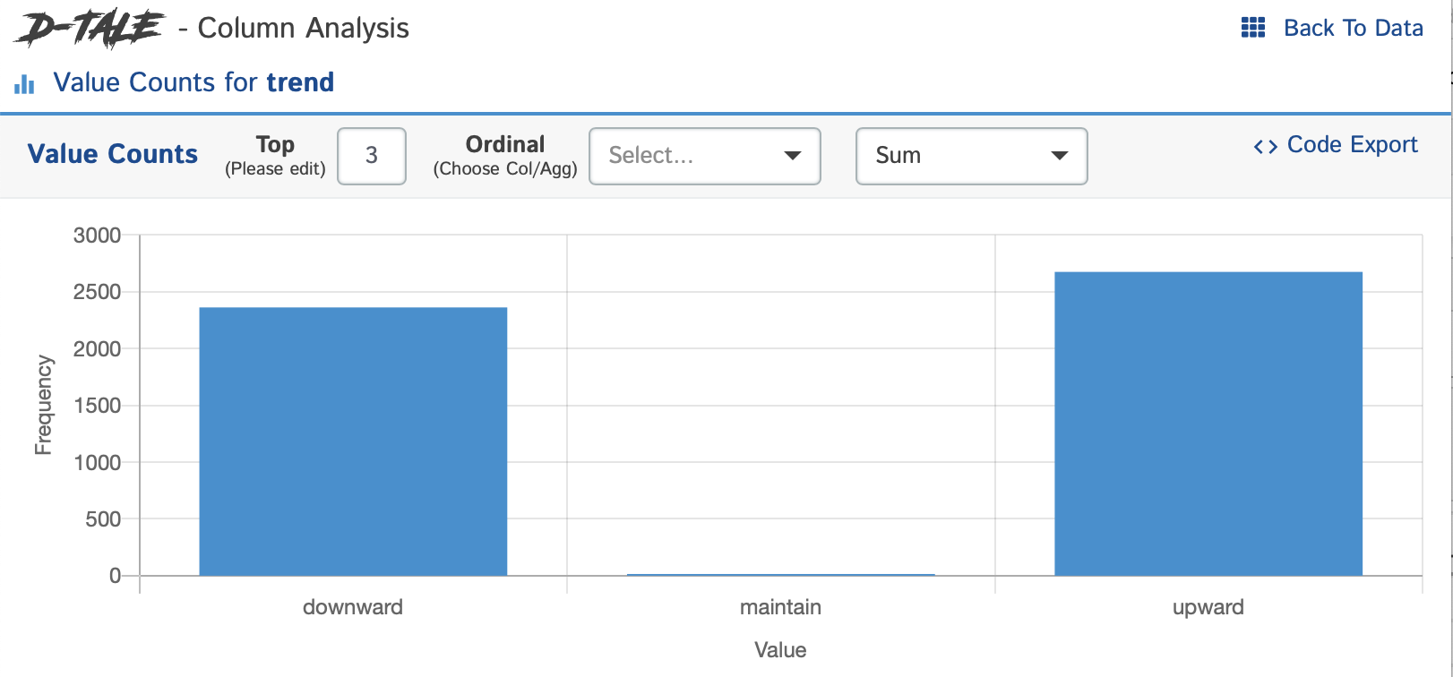
HISTOGRAM
Crude oil price downward trend happened 2,362 times whereas 2,675 times upward trend. Only 15 times crude oil price maintain in the past 20 years

Slide 7
BOX PLOT
Displaying the data distribution through their quartiles and detect outliers

Slide 8
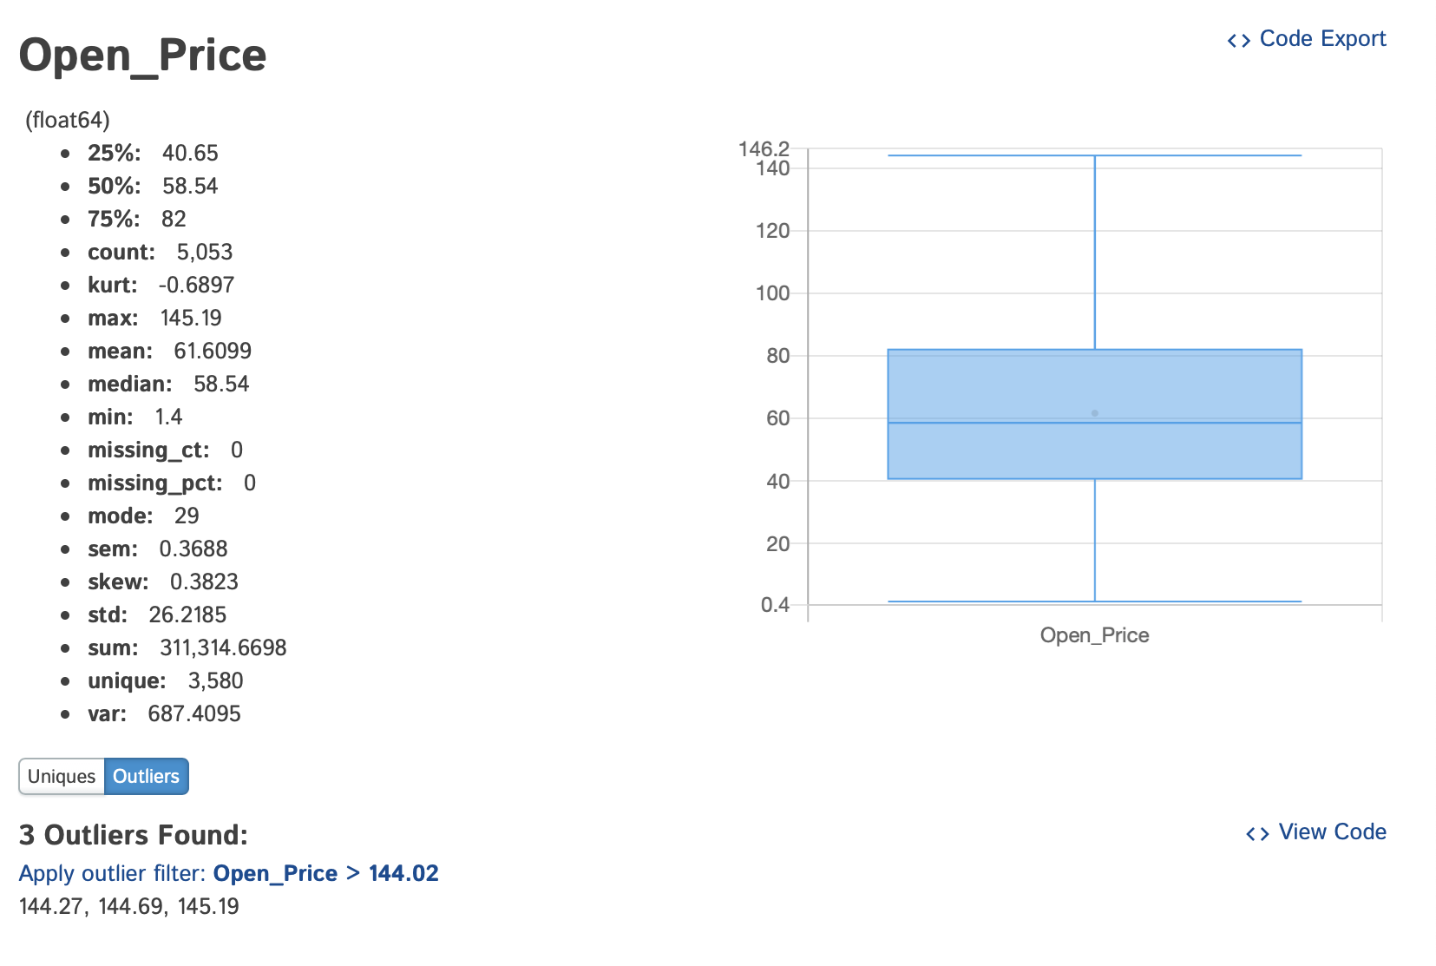
BOX PLOT OF DAILY OPEN PRICE
Summary of statistical data
3 outliers found in crude oil Open Price which these prices are above USD 144.02

Slide 9
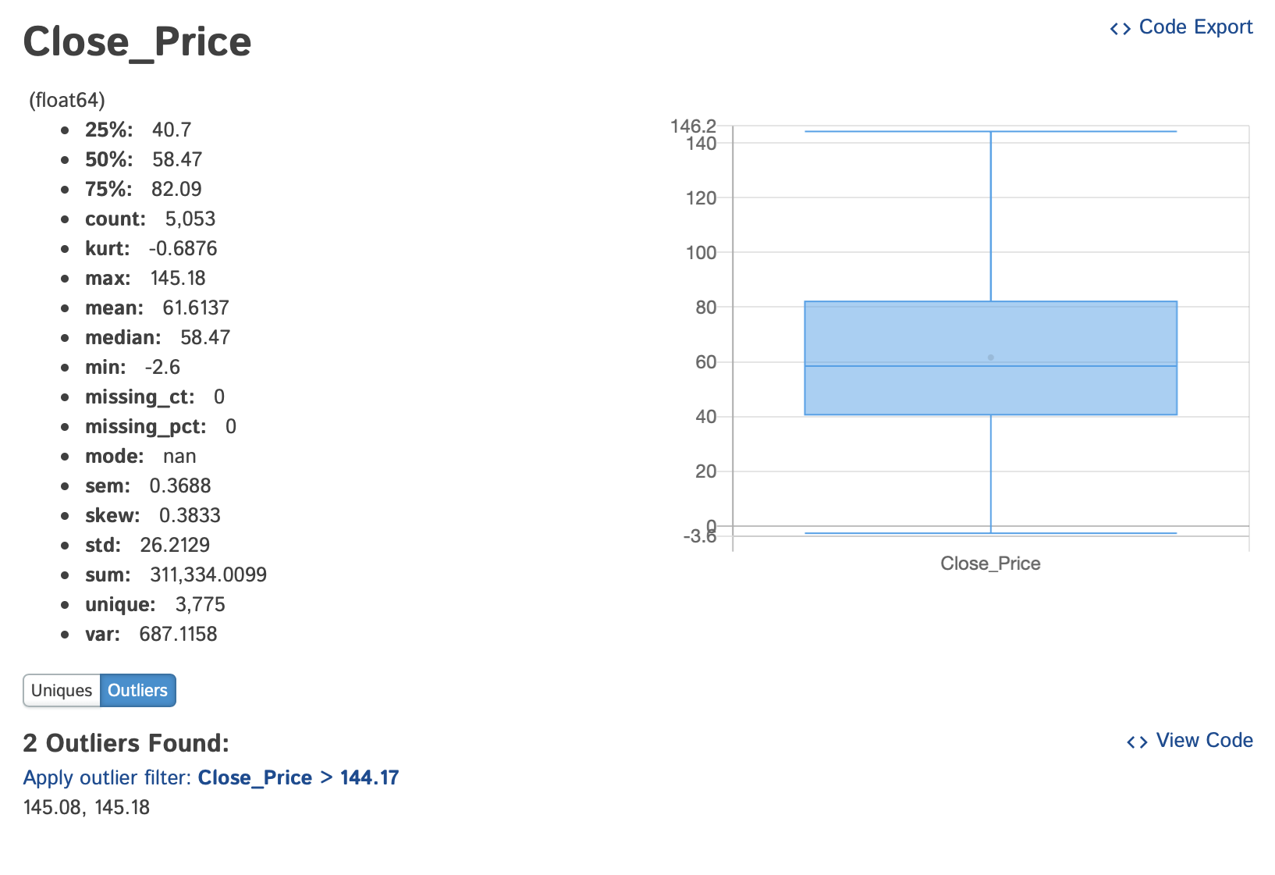
BOX PLOT OF DAILY CLOSE PRICE
Summary of statistical data
2 outliers found in crude oil Close Price which are USD 145.08 and USD 145.18

Slide 10
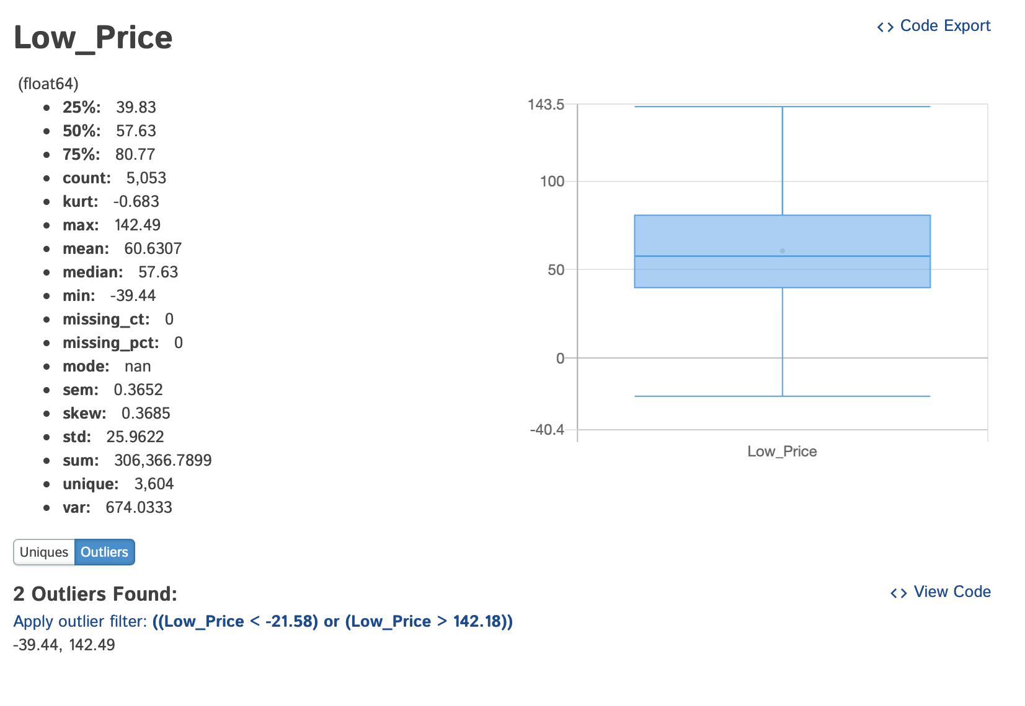
BOX PLOT OF DAILY LOW PRICE
Summary of statistical data
2 outliers found in crude oil Low Price which are USD 142.49 and – USD 39.44

Slide 11
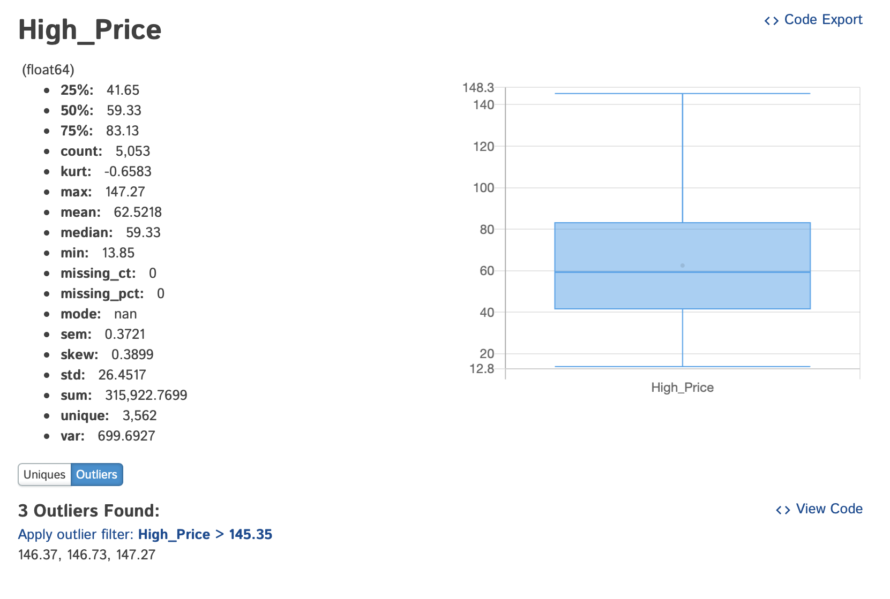
BOX PLOT OF DAILY HIGH PRICE
Summary of statistical data
3 outliers found in crude oil High Price which are USD 146.37, USD 146.73 and USD 147.27

Slide 12
CORRELATION MATRIX
Table showing correlation coefficients between sets of variables. This allows you to see which pairs have the highest correlation.

Slide 13
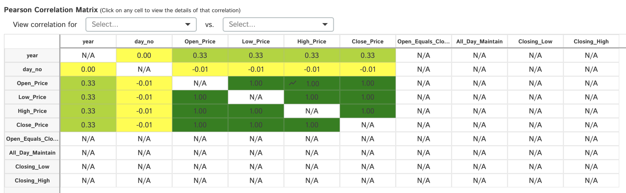
CORRELATION MATRIX OF CRUDE OIL PRICE DATASET
Variable day_no has very weak relationship between all variable of prices
Variable year has medium strength relationship between all variable of prices
All four variable of prices indicated to have strong relationship between variable being tested

Slide 14
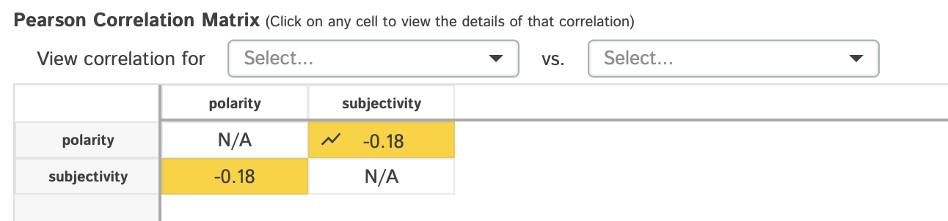
CORRELATION MATRIX OF NEWS DATASET
Variable Polarity and Subjectivity has weak relationship (close to zero) between the variables being tested

Slide 15
LINE GRAPH
( TIME SERIES ANALYSIS )
Used to display quantitative values over a continuous interval or time period. A Line Graph is most frequently used to show trends and analyse how the data has changed over time.

Slide 16
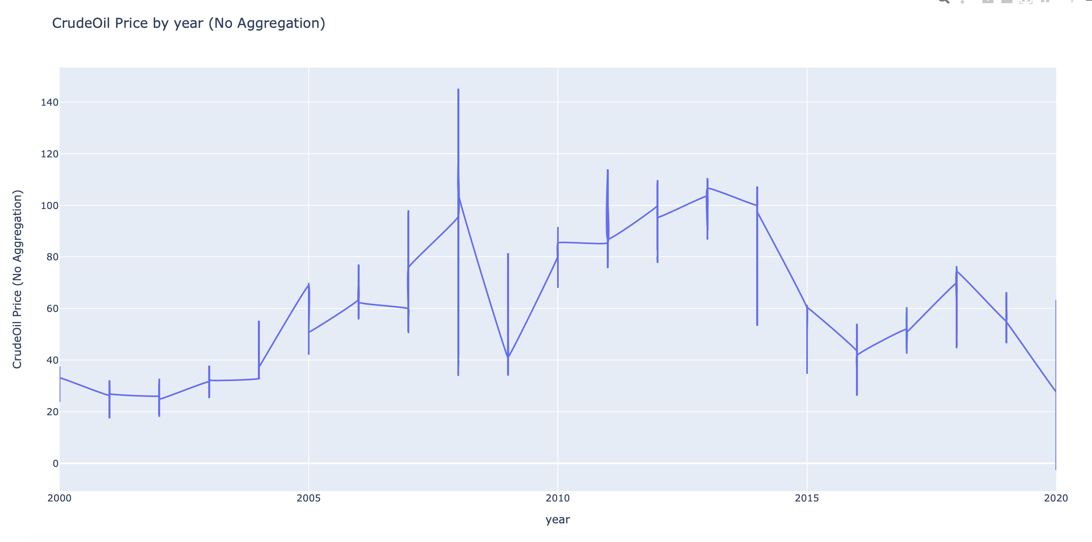
DAILY CRUDE OIL PRICE FROM 2000 – JUNE 2020
Crude oil price showed steady uptrend since 2001 until 2008 and then showed unstable trend since then.
Maximum crude oil price recorded is USD 145.19 and minimum close price recorded is -USD 2.60.
Note that negative value means that the cost of handling crude oil storage is higher than the market price at that point of time

Slide 17
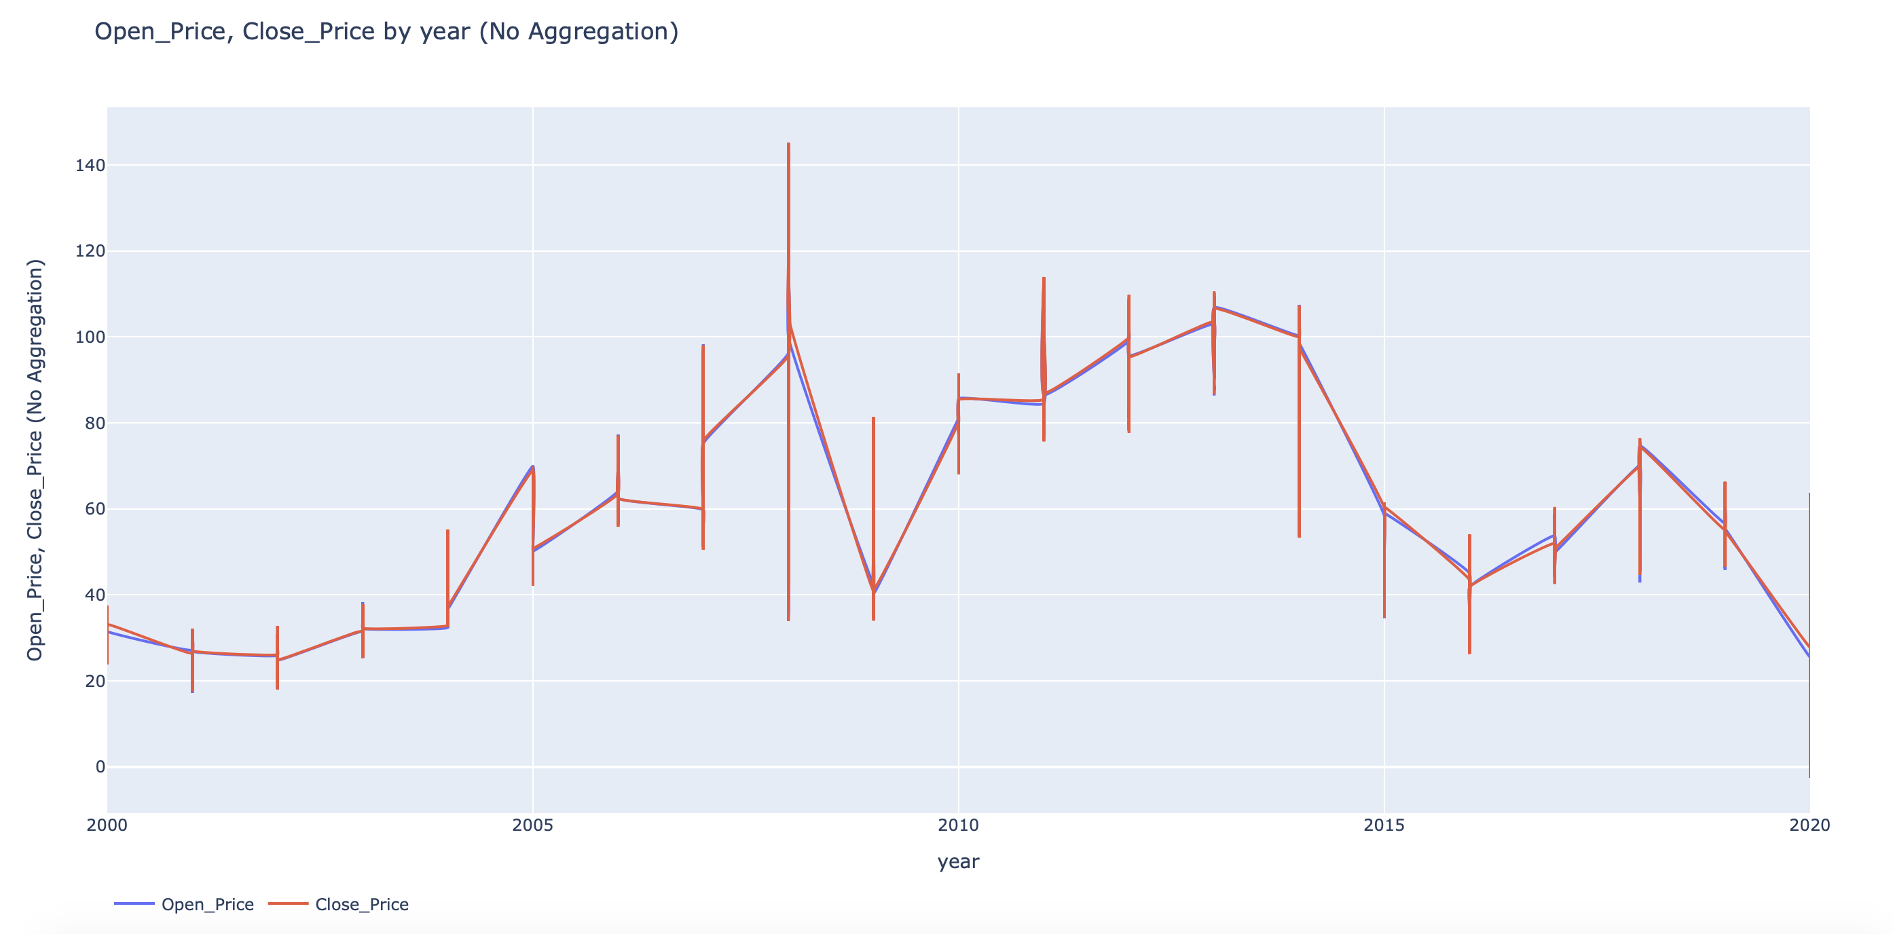
DAILY OPEN AND CLOSE PRICE TREND FROM YEAR 2000 – JUNE 2020
Low price and high price shown similar trending over the past 20 years.
No significant price gap between these 2 prices

Slide 18
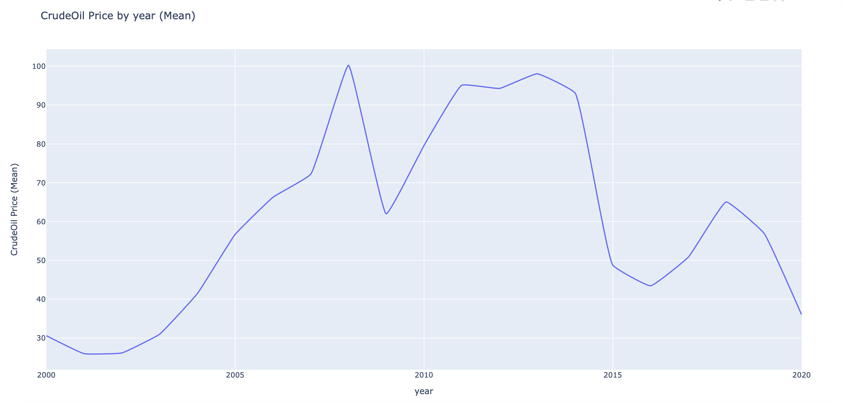
DAILY CRUDE OIL PRICE (MEAN) FROM 2000 – JUNE 2020
The mean of Close Price showed significant spike in year 2008 (USD 100.23), and crude oil price crashed down in year 2009 (USD 61.98). The trend shown another in year 2016 (USD 43.44) and 2020 (USD 35.96)

Slide 19
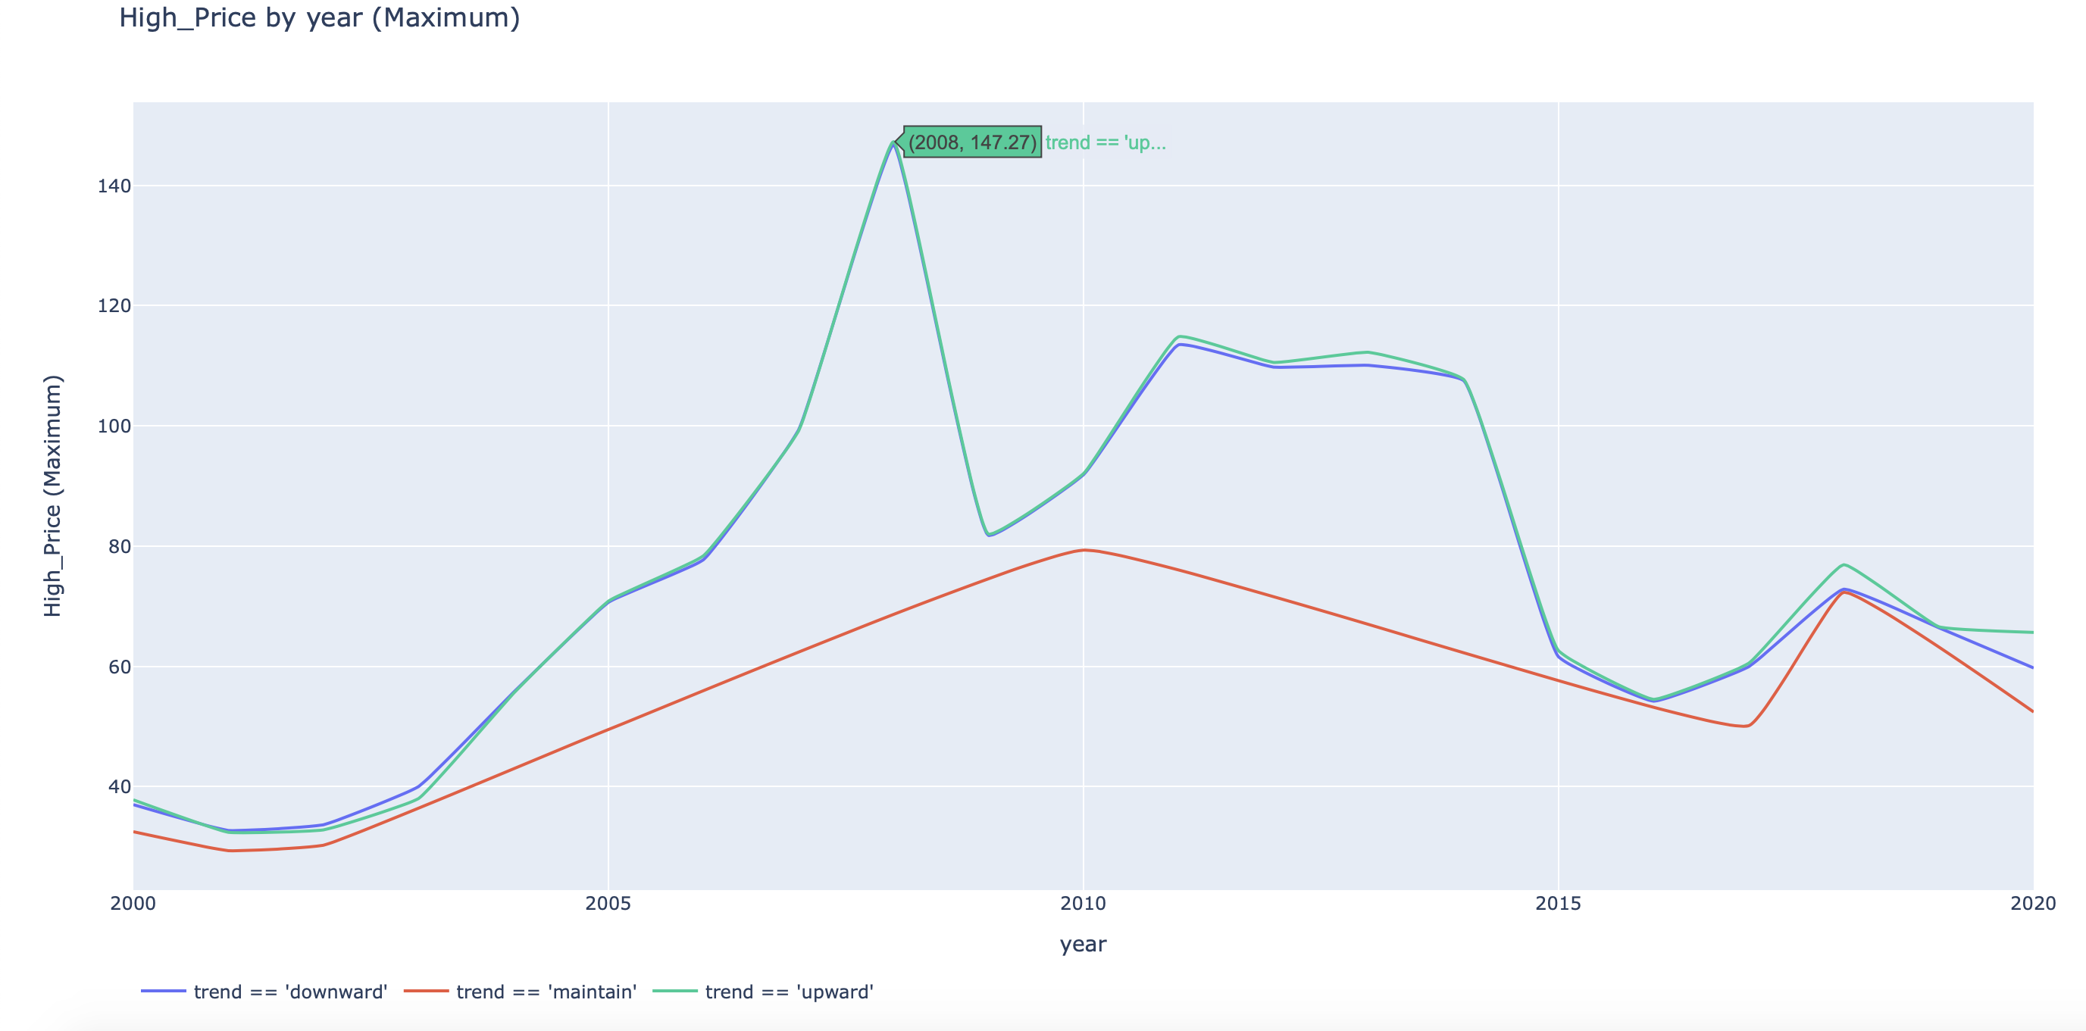
MAXIMUM PRICE TREND FOR DAILY HIGH PRICE FROM 2000 – JUNE 2020
Maximum value of High Price with trending crude oil price (Downward, Maintain, Upward)
The HIGHEST price recorded at USD 147.27

Slide 20
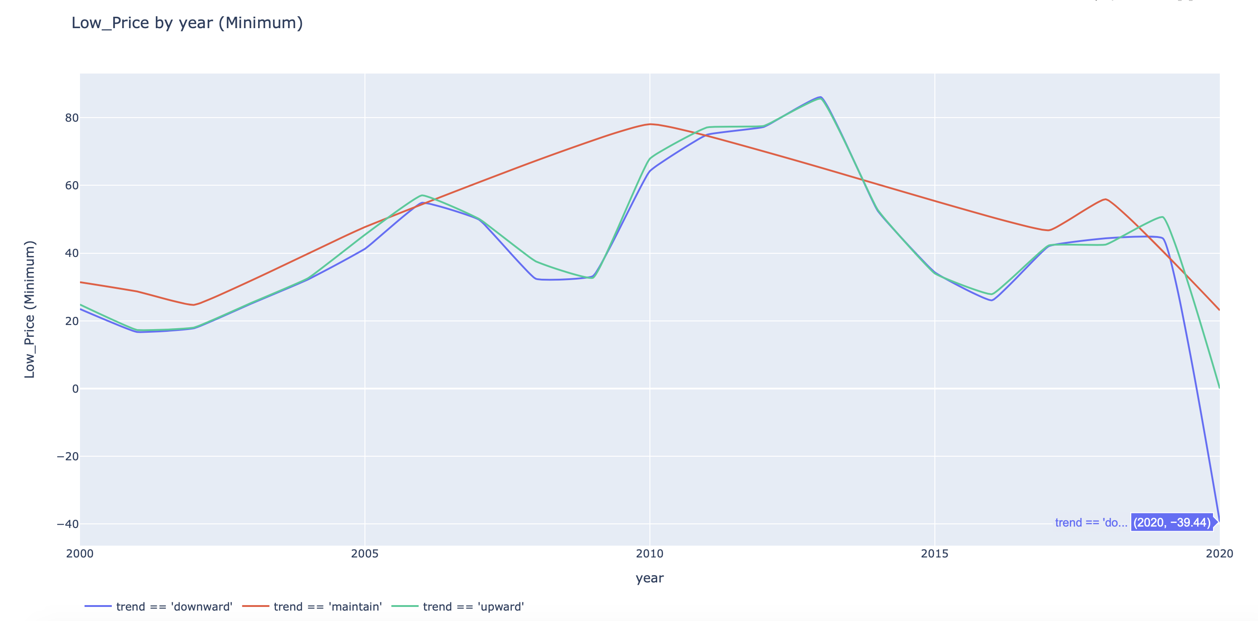
MINIMUM PRICE TREND FOR DAILY LOW PRICE FROM 2000 – JUNE 2020
Minimum value of Low Price with trending crude oil price (Downward, Maintain, Upward)
The LEAST price recorded at - USD 39.44

Slide 21
BAR GRAPH
To show discrete, numerical comparisons across categories. Answers the question of "how many?" in each category.

Slide 22
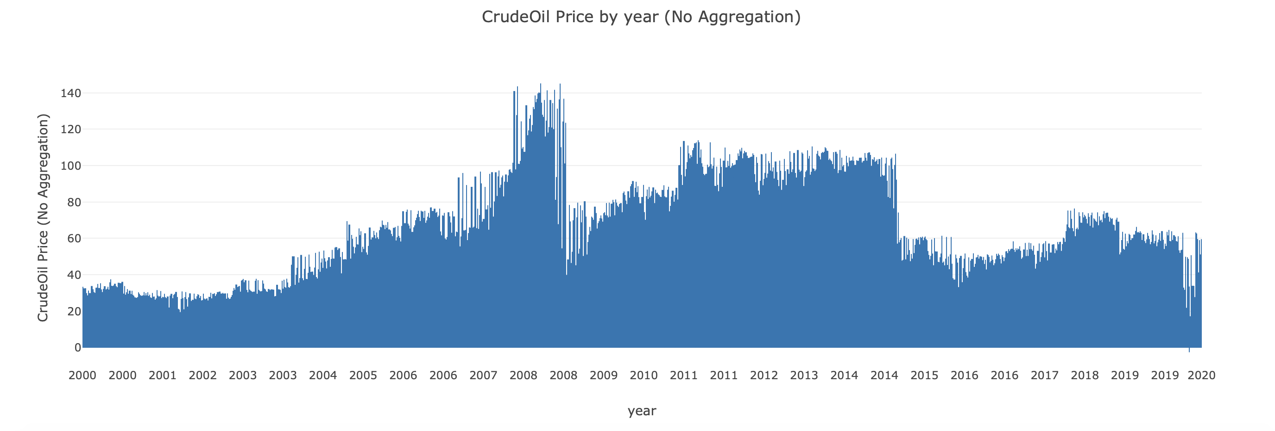
DAILY CRUDE OIL PRICE FROM 2000 – JUNE 2020
Bar graph crude oil price showed steady uptrend since 2001 until 2008 and then showed unstable trend since then.

Slide 23
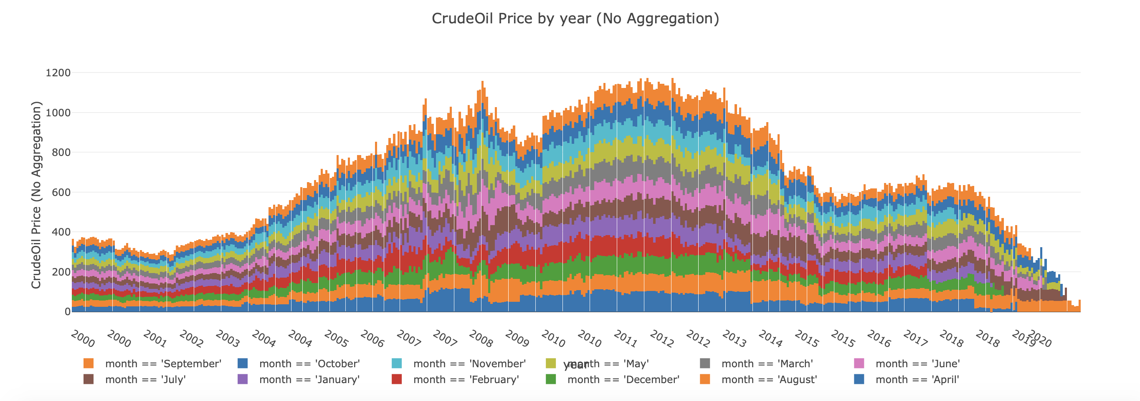
DAILY CRUDE OIL PRICE FROM 2000 – JUNE 2020 GROUPED BY MONTH

Slide 24
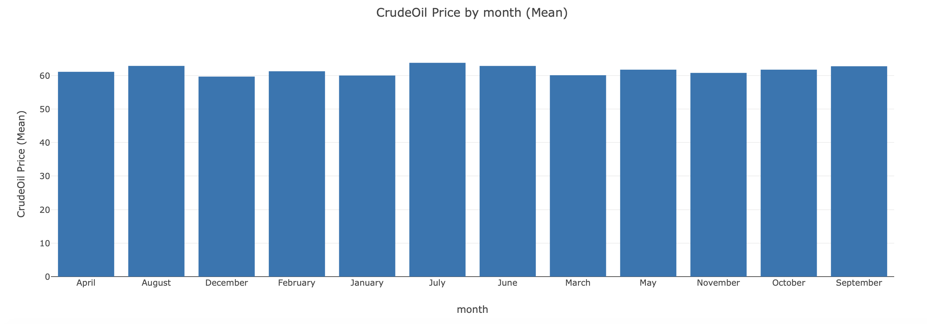
MONTHLY CRUDE OIL PRICE (MEAN) FROM 2000 – JUNE 2020
In average, high crude oil price in month of June, July and August for the past 20 years

Slide 25
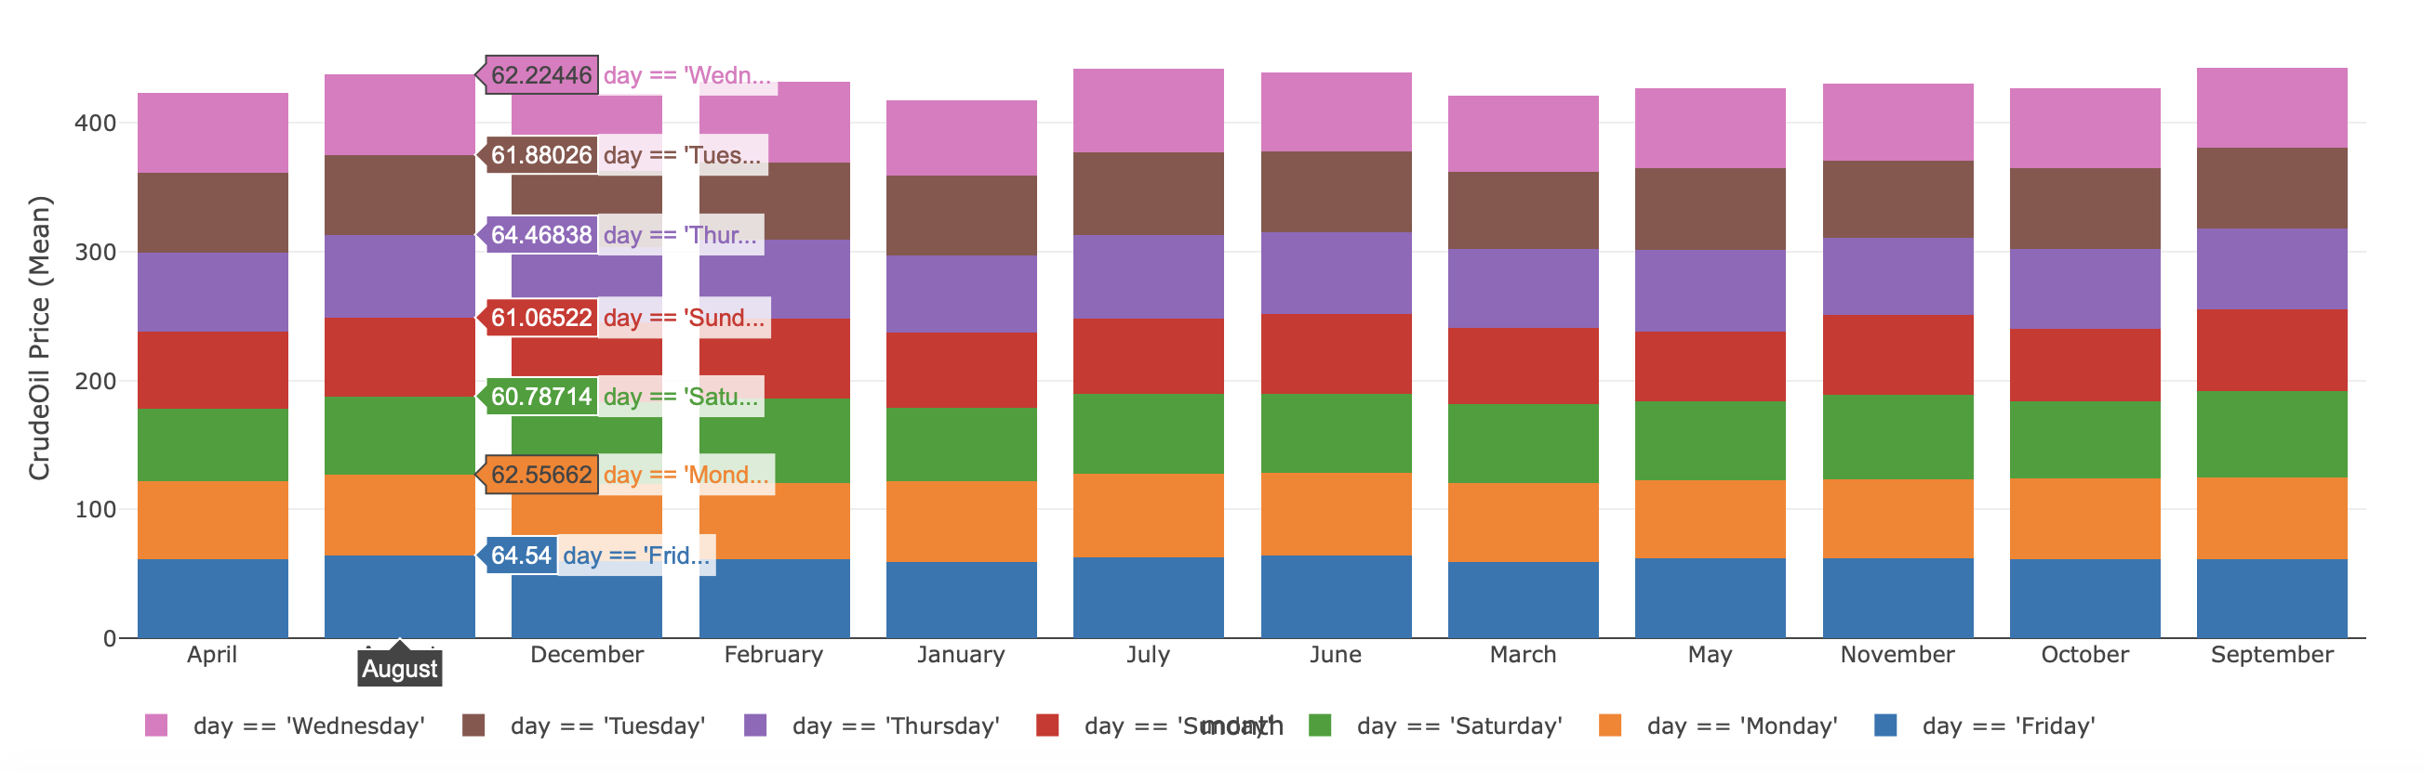
MONTHLY CRUDE OIL PRICE (MEAN) FROM 2000 – JUNE 2020 STACKED BY DAY
Mean crude oil price for the past 20 years by month with day color coded
In average, high crude oil price in month of June, July and August for the past 20 years

Slide 26
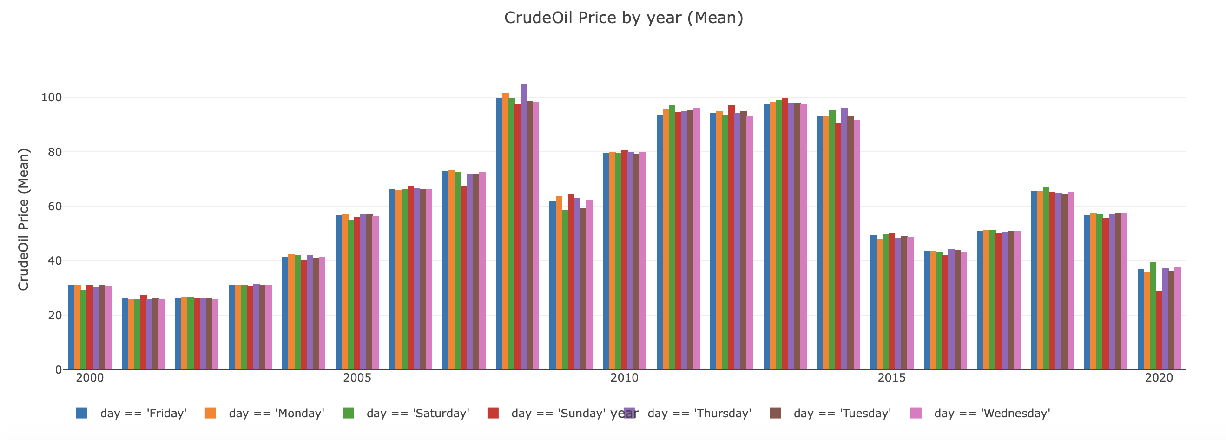
MONTHLY CRUDE OIL PRICE (MEAN) FROM 2000 – JUNE 2020 GROUPED BY DAY
Mean crude oil price trend by year and day

Slide 27
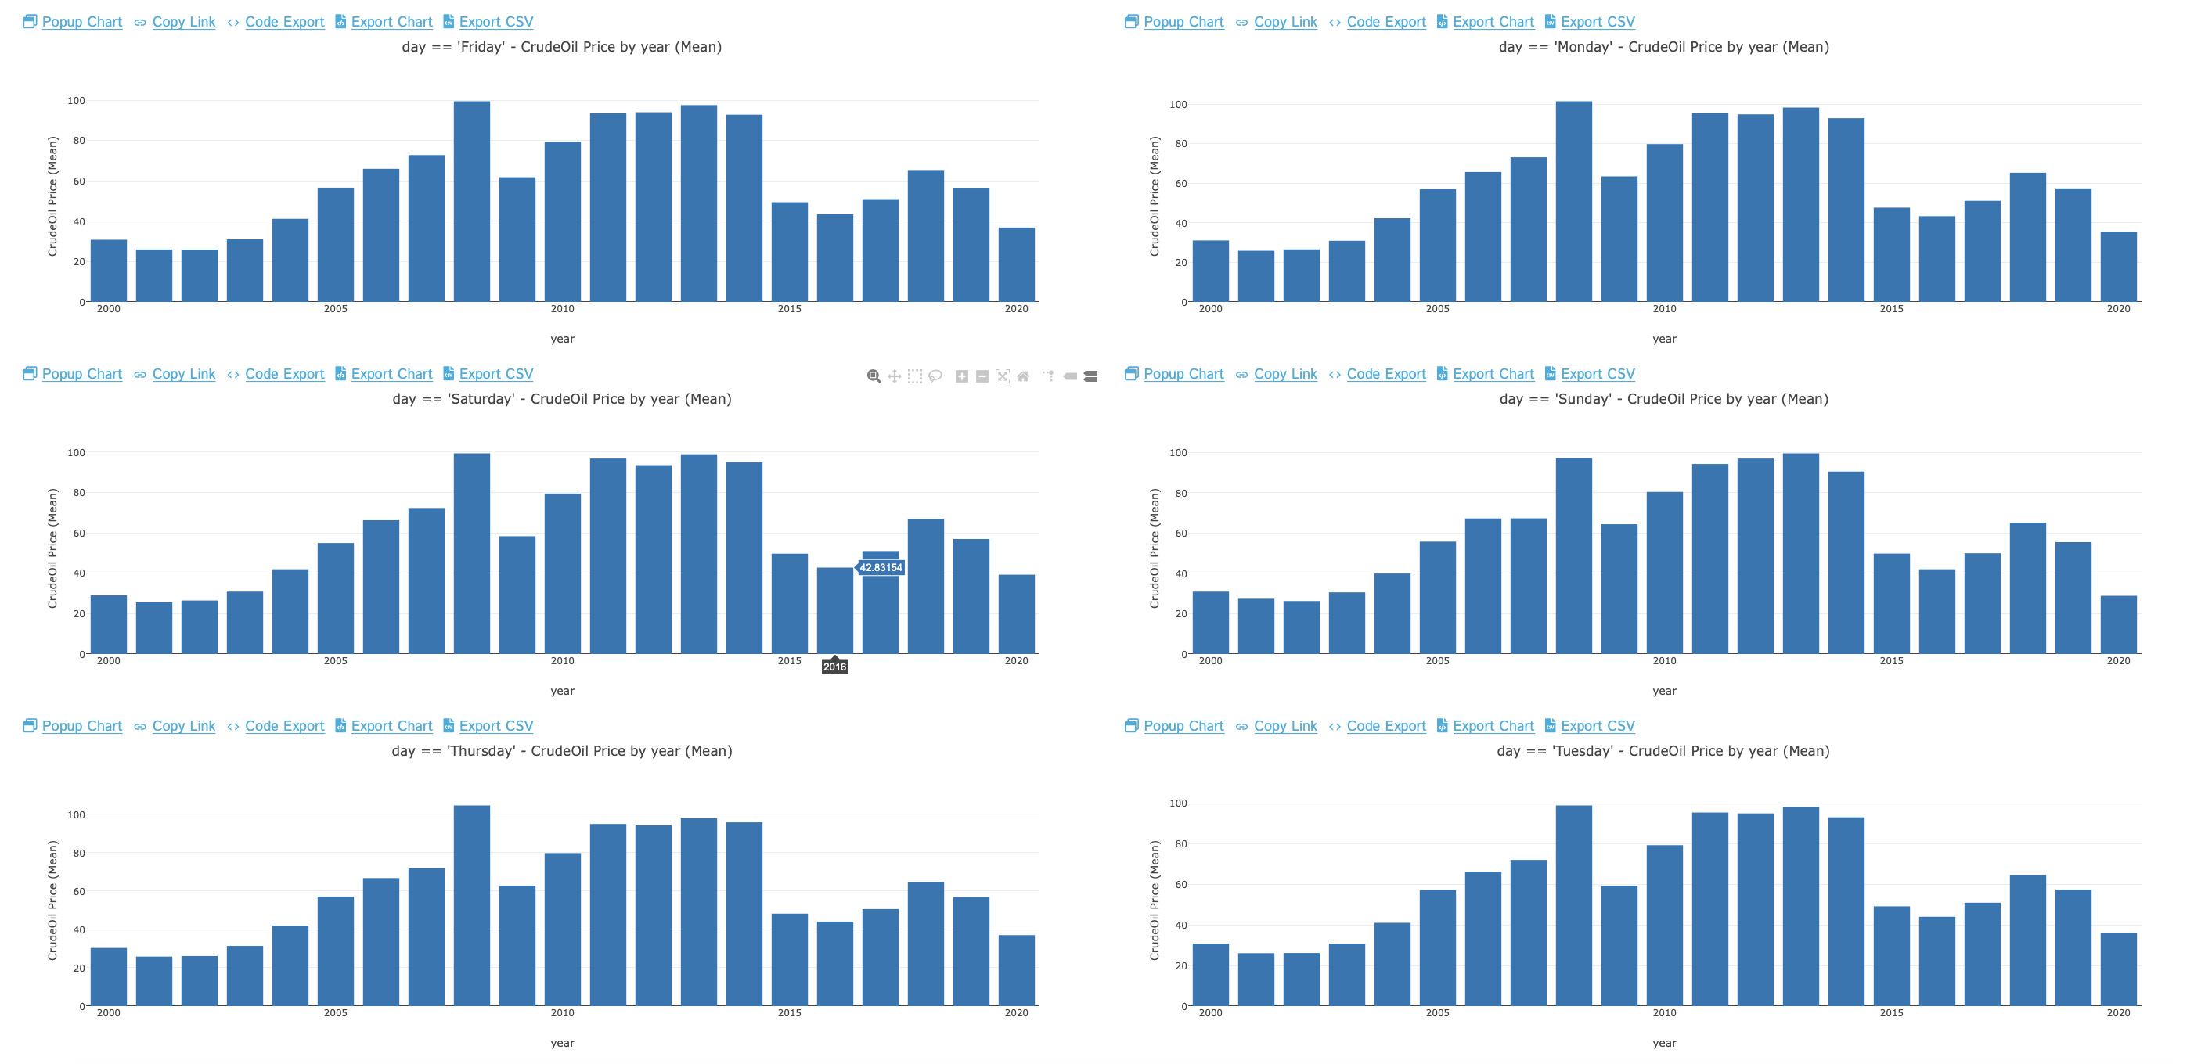
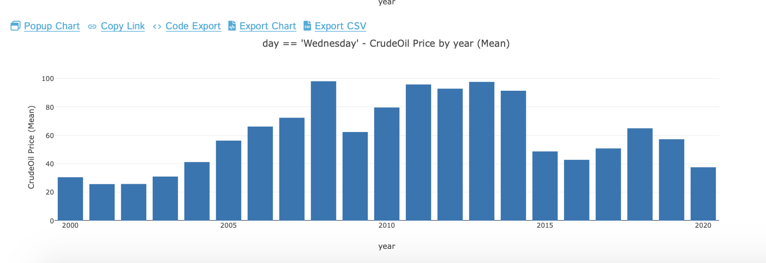
MEAN CRUDE OIL PRICE DISTRIBUTION BY DAY

Slide 28
PIE CHART
Help show proportions and percentages between categories, by dividing a circle into proportional segments.

Slide 29
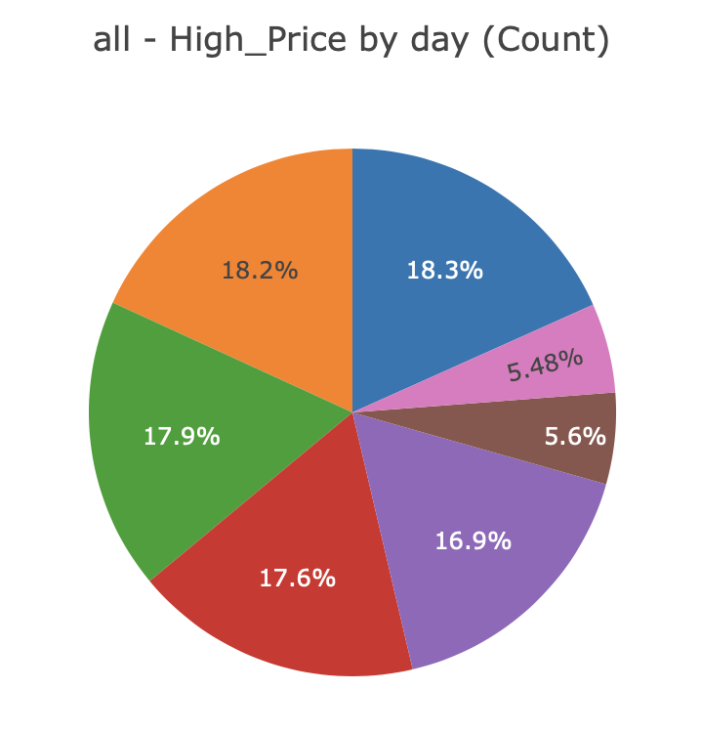
PIE CHART OF HIGH CRUDE OIL PRICE BY DAY
High price mostly happened on Monday (18.3%) and least on Saturday (5.48%)

Slide 30
SCATTER PLOT & 3D SCATTER
Display values from two variables. By displaying a variable in each axis, we can detect if a relationship or correlation between the two variables exists.

Slide 31
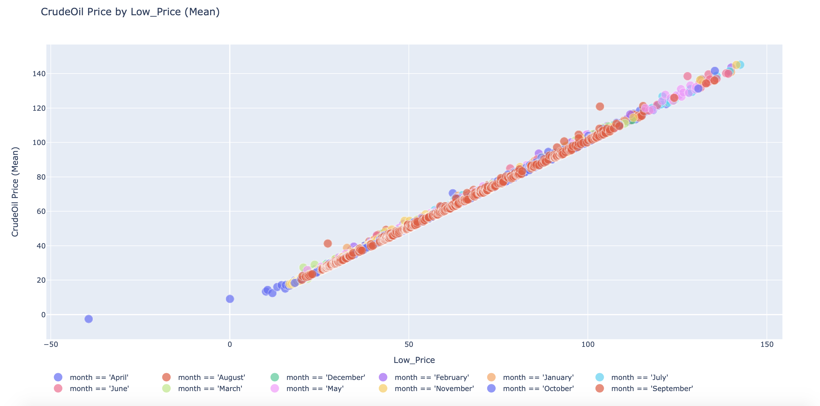
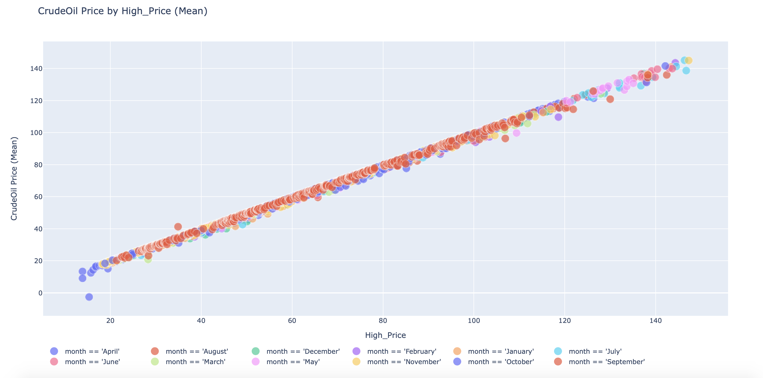
SCATTER PLOT OF DAILY CRUDE OIL, LOW AND HIGH PRICE
Crude Oil Price has positive strong relationship with daily Low Price and High Price.
Only few data point showed irregular trend out of 5000 data in total

Slide 32
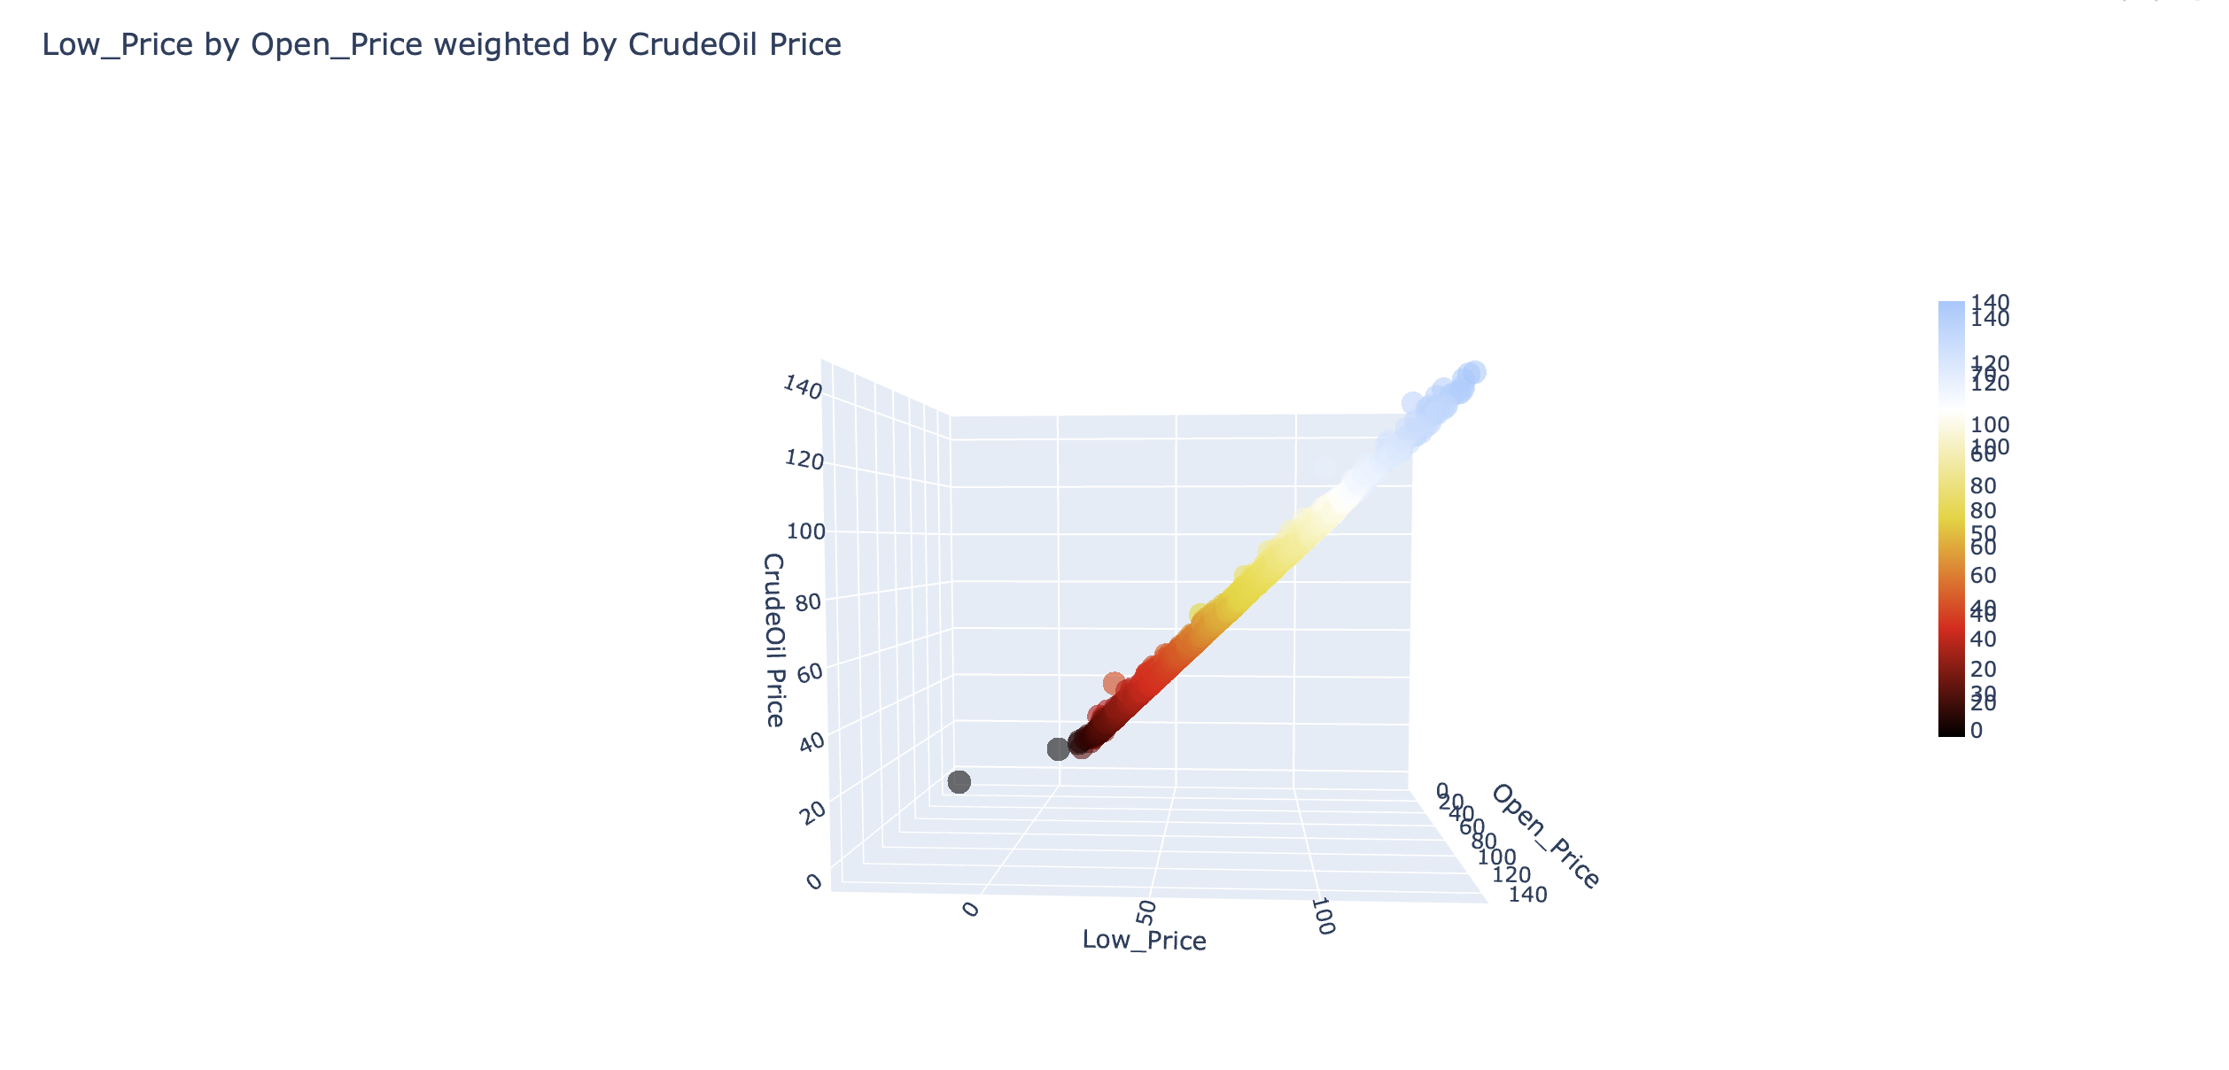
3D SCATTER OF DAILY CRUDE OIL, LOW AND OPEN PRICE
Low Price, Open Price and Crude Oil Price shown positive strong correlation

Slide 33
WORD CLOUD
Displays how frequently words appear in a given body of text, by making the size of each word proportional to its frequency.

Slide 34
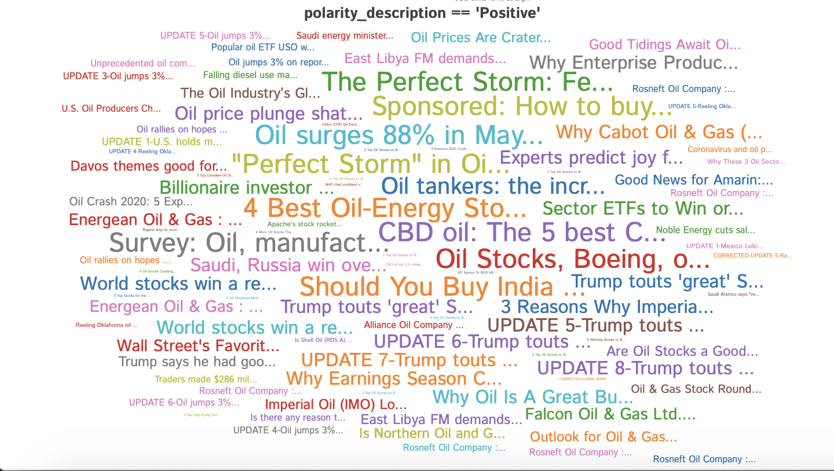
WORD CLOUD
Word cloud of the news headlines with ‘Positive’ polarity

Slide 35
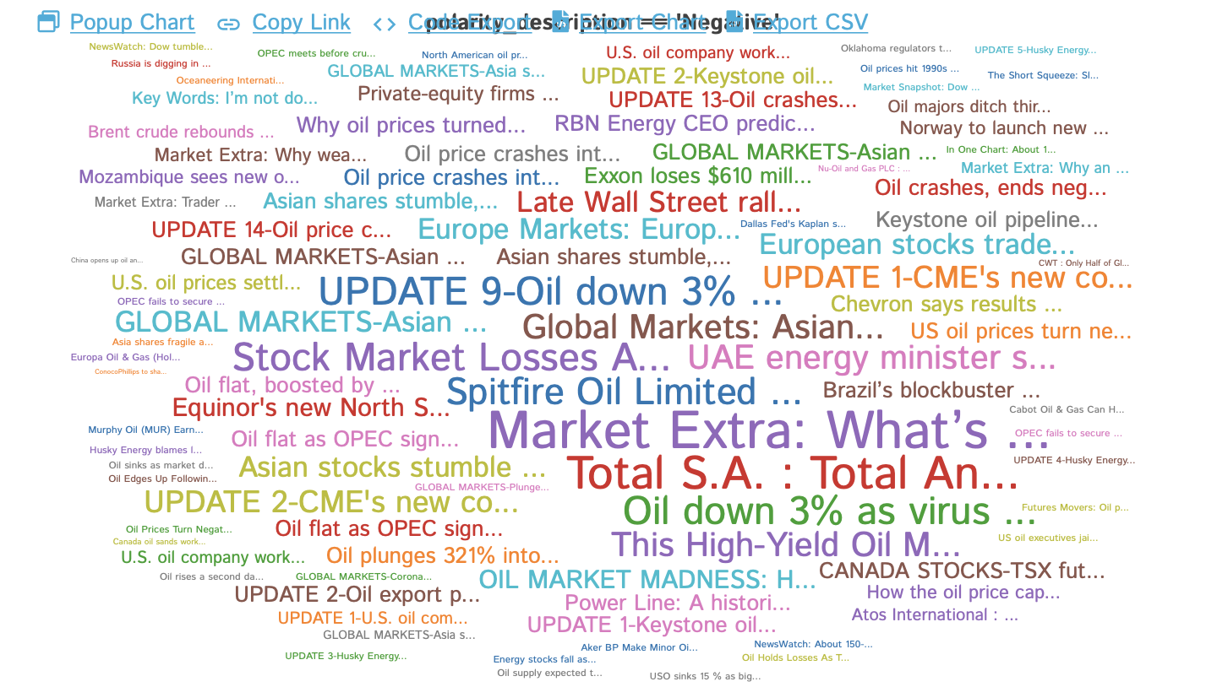
WORD CLOUD
Word cloud of the news headlines with ‘Negative’ polarity

Slide 36
SUMMARY
The increase in demand and use for medium and heavy-duty vehicles is paving way for growth in the crude oil market. Petrol, kerosene and diesels are products from crude oil energy remain the main source of energy for the transportation industry. Other areas where crude oil is used includes power grid generation, detergents, plastics, synthetic fibers and synthetic rubbers.
This wide usage of fuels lead to global crude oil market charting a steady growth curve ever since year 2000.
Crude oil prices are substantially determined by the supply-demand relationship. However big fall in crude oil prices beginning 2014 until present due excess supply of crude oil and price war among big crude oil producer (Saudi Arabia, Russia and America). This fluctuation is caused excess supply of discounted crude oil price.
From 2014 to the present, oil prices have fallen by as much as 70%
COVID-19 has cut the global demand up to 33%. The major upset was due to travel shutdown around the world amid COVID-19 pandemic.
Based on the model, crude oil price forecasted to be declines calmly in year 2020.

